Slide 1
Error Correction(7bit data)

Slide 2
Error Correction
~ can be handled in two ways
✶ when an error is discovered, the receiver can have the sender retransmit the entire data unit.
✴ a receiver can use an error-correcting code, which automatically corrects certain errors.

Slide 3
Error Correction(cont’d)
Single-Bit Error Correction
parity bit
The secret of error correction is to locate the invalid bit or bits
For ASCII code, it needs a three-bit redundancy code(000-111)

Slide 4
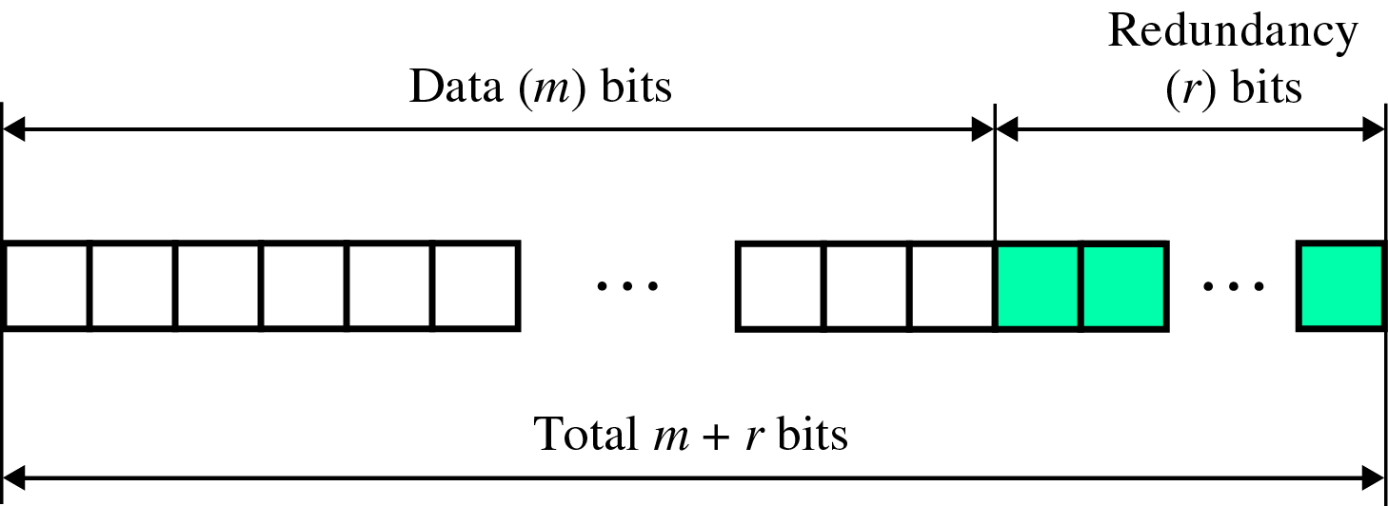
Error Correction(cont’d)
Redundancy Bits
~ to calculate the number of redundancy bits (R) required to correct a given number of data bit (M)

Slide 5
Error Correction(cont’d)
If the total number of bits in a transmittable unit is m+r, then r must be able to indicate at least m+r+1 different states
2^{r} ≥ m + r + 1
ex) For value of m is 7(ASCII), the smallest r value that can satisfy this equation is 4
2⁴ ≥ 7 + 4 + 1

Slide 6
Error Correction(cont’d)
Relationship between data and redundancy bits
Number of Data Bits
(m)
Number of Redundancy Bits
(r)
Total Bits
(m+r)
1
2
3
4
5
6
7
2
3
3
3
4
4
4
3
5
6
7
9
10
11

Slide 7
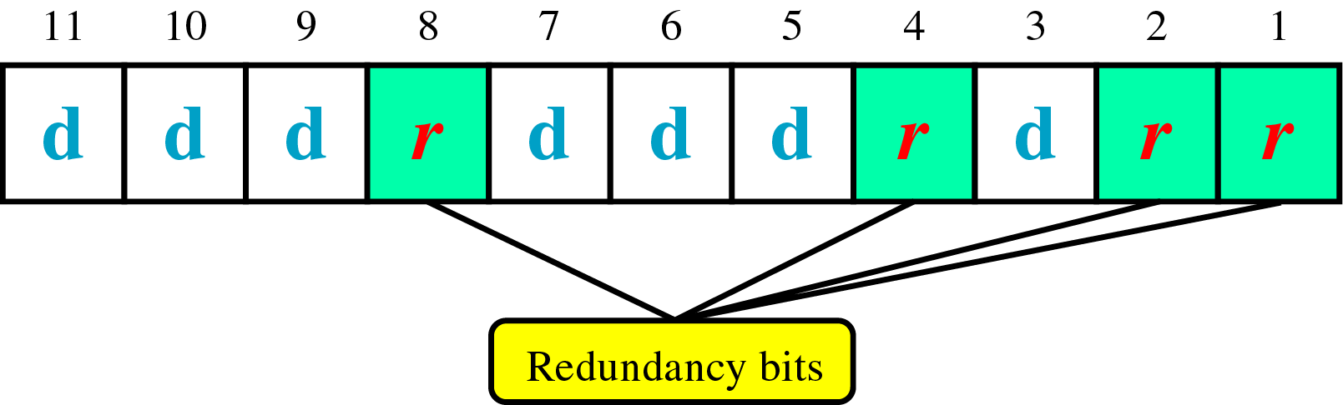
Error Correction(cont’d)
Hamming Code
~ developed by R.W.Hamming
positions of redundancy bits in Hamming code

Slide 8
Error Correction(cont’d)
each r bit is the VRC bit for one combination of data bits
r₁ = bits 1, 3, 5, 7, 9, 11
r₂ = bits 2, 3, 6, 7, 10, 11
r₄ = bits 4, 5, 6, 7
r₈ = bits 8, 9, 10, 11

Slide 9
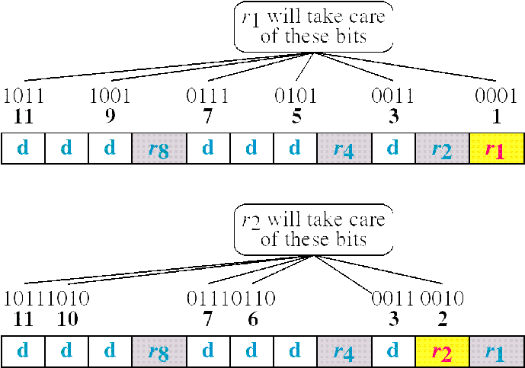
Error Correction(cont’d)
Redundancy bits calculation(cont’d)

Slide 10
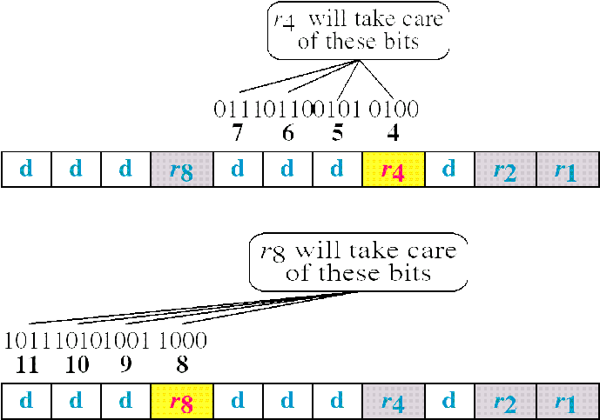
Error Correction(cont’d)
Redundancy bits calculation

Slide 11
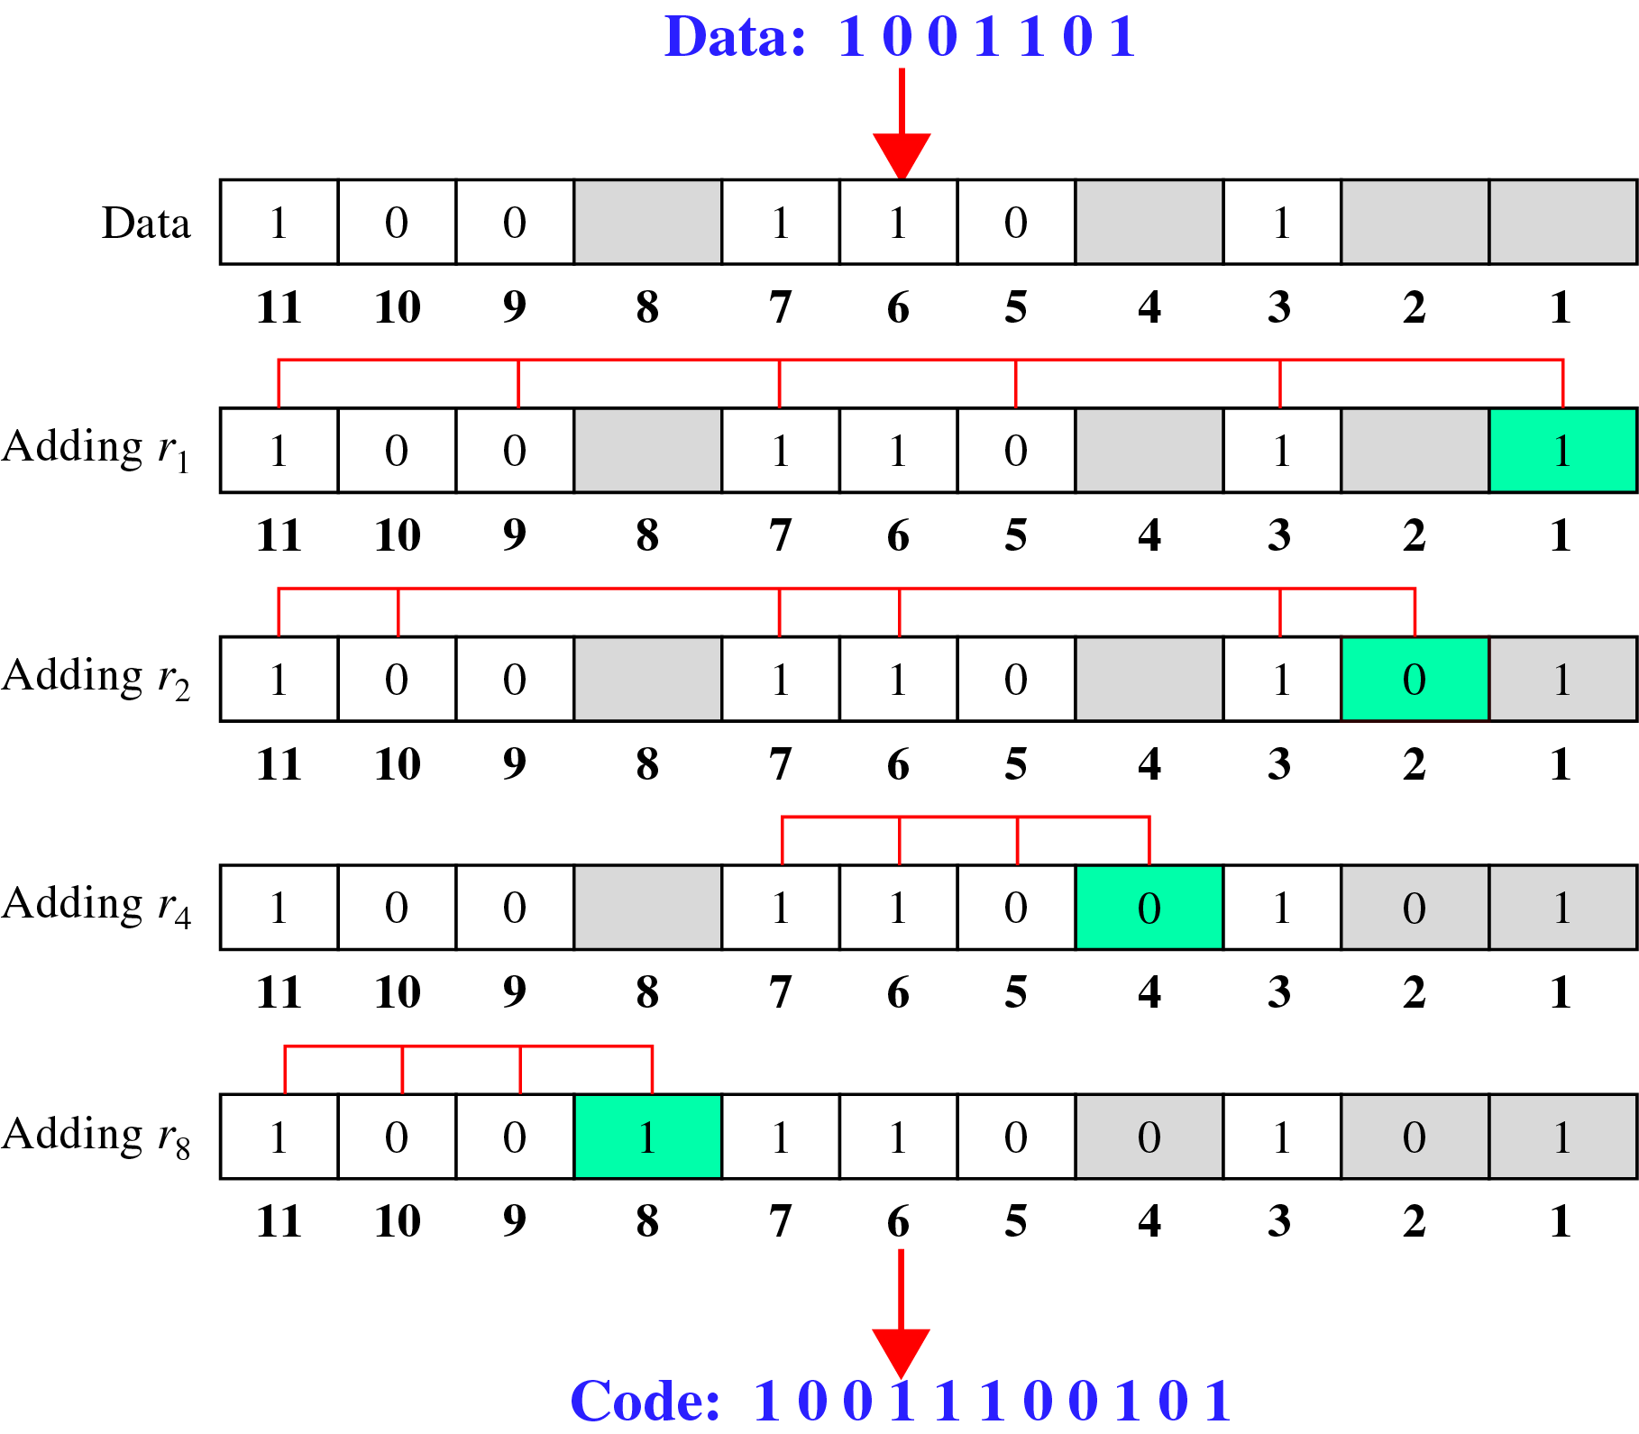
Error Correction(cont’d)
Calculating the r values
Calculating Even Parity

Slide 12
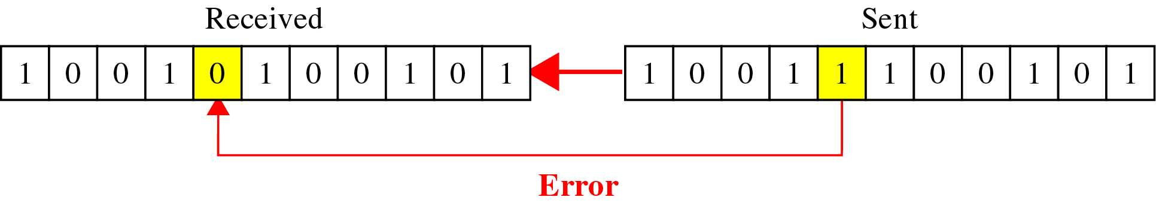
Error Correction(cont’d)
Error Detection and Correction

Slide 13
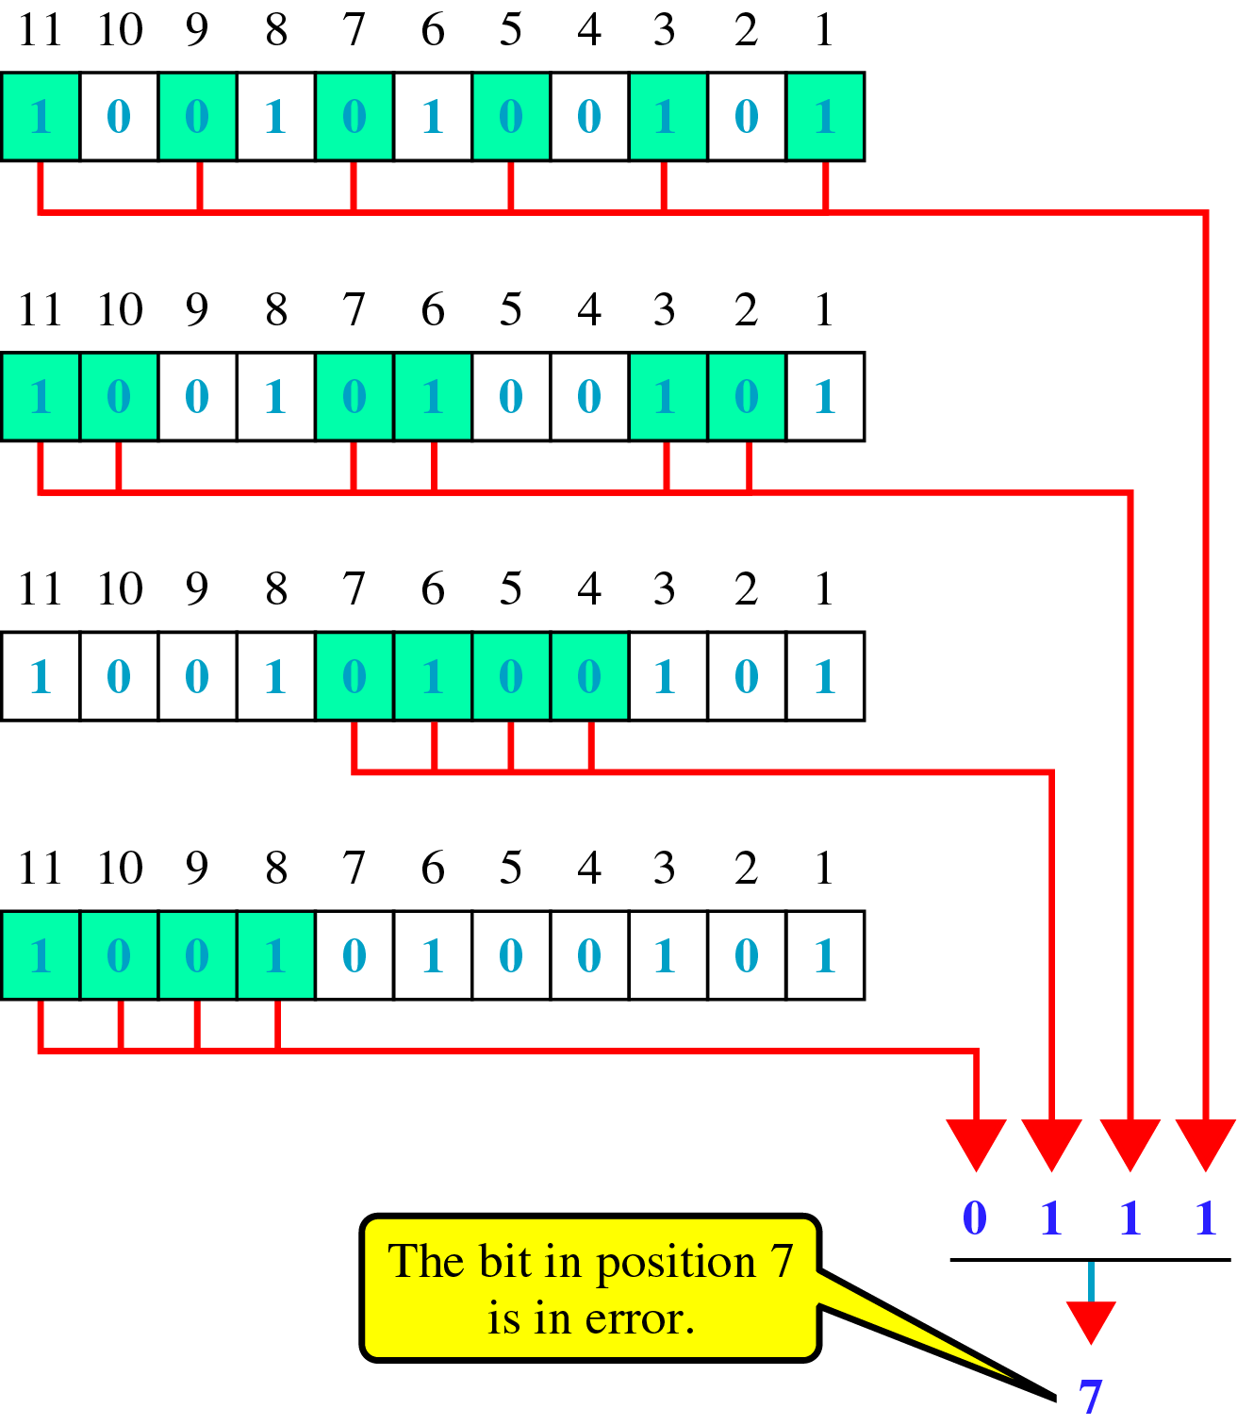
Error Correction(cont’d)
Error detection using Hamming Code

Slide 14
Error Correction(cont’d)
Multiple-Bit Error Correction
redundancy bits calculated on overlapping sets of data units can also be used to correct multiple-bit errors.
Ex) to correct double-bit errors, we must take into consideration that two bits can be a combination of any two bits in the entire sequence

